Slide 1
Big Mountain Ski Resort Executive Report
Data Scientist: Raymond Chai
Date: Jan. 08, 2022

Slide 2
Problem Identification
Adjusting ticket prices:
Big Mountain Ski Resort Current Ticket Price: $81
Is Big mountain Ski resort’s ticket price, competitively priced for the features it has compared to the market?
__________________________________________________________________________________
Exploring options to improve/optimize Big Mountain Ski Resort:
Option 1: Closing up to the 10 of the least used runs
Option 2: Adding 150 ft of vertical drop to the tallest run, adding an additional ski lift chair
Option 3: Similar to Option 2, but with additional snow coverage capability
Option 4: Adding 0.2 miles of run to the longest run and providing additional snow coverage capability
Which of these options can reduce costs or improve revenue for Big Mountain Ski Resort?

Slide 3
Recommendations and Key Findings
Adjusting ticket prices:
Big Mountain Ski Resort Current Ticket Price: $81
Big Mountain Ski resort Ticket price expected: $95.87 +/- $10.39
Is Big mountain Ski resort’s ticket price, competitively priced for the features it has compared to the market?
It seems Big Mountain Ski resort’s ticket price can be upped from the model built on market data.
__________________________________________________________________________________
Exploring options to improve/optimize Big Mountain Ski Resort:
Option 1: Closing up to the 10 of the least used runs
Reduction in ticket price with certain number of least used runs closed.
Option 2: Adding 150 ft of vertical drop to the tallest run, adding an additional ski lift chair
Additional features could improve ticket price to be $1.99 more!
Option 3: Similar to Option 2, but with additional snow coverage capability
Addition of more snow coverage does not improve ticket price any more than option 2.
Option 4: Adding 0.2 miles of run to the longest run and providing additional snow coverage capability
No change in ticket price.
Which of these options can reduce costs or improve revenue for Big Mountain Ski Resort?
Of the provided options to explore, Option 1 & 2 are the financially interesting.

Slide 4
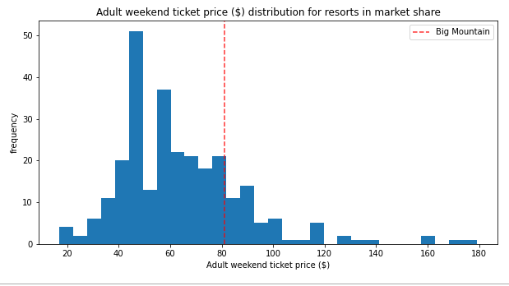
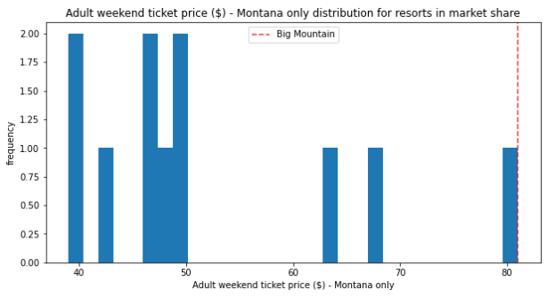
Modeling results and analysis
Big Mountain Ski Resort (B.M.S.R.) ticket prices (dotted red line) relative to all ski resorts in the U.S. (left) and ski-resorts in Montana only (right)
Background: B.M.S.R. appears to be priced near the median price point in respect to the entire market for ski tickets, however it’s the highest priced resort ticket in Montana. In the summary section, B.M.S.R.’s potential price up will be explained with respective to the graphs shown in the next few slides.
Variables that dictate the ticket pricing:
1.) Max vertical drop height, 2.) amount of available made snow, 3.) total number of chairs, 4.) number of quads (chair lift for 4 people), 5.) number of runs, 6.) longest run length, 7.) trams (aerial lift via cable car), 8.) total amount of skiable terrain

Slide 5
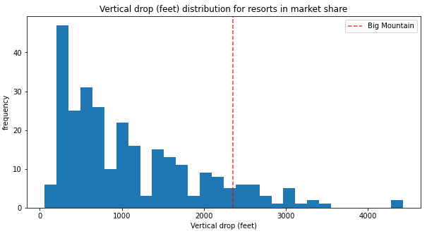
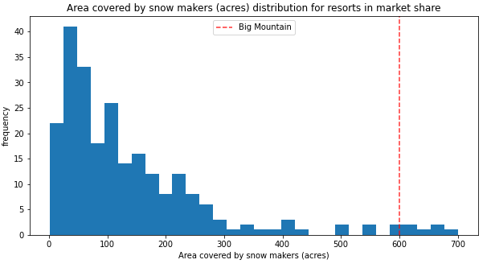
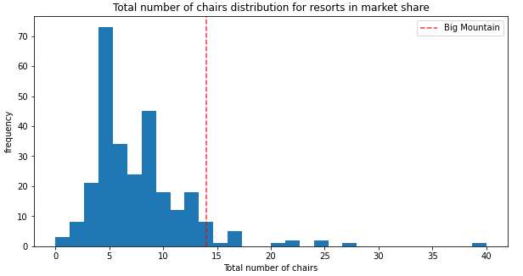
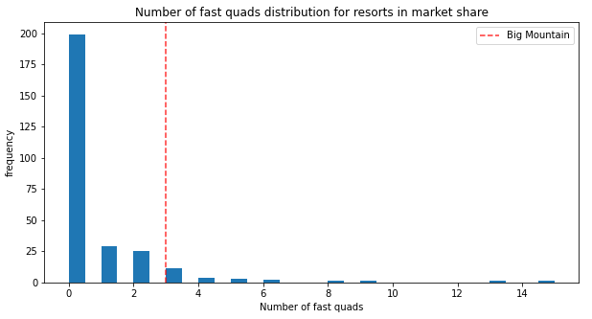
Modeling results and analysis (cont.)
Above are graphs of all the ski resorts focusing on one variable that would dictate the ski ticket price. Shown above respectively, B.M.S.R. has higher than average vertical drops (top left), amount of snow covering available (top right), total number of chairs (bottom left) and number of fast quads (bottom right).

Slide 6
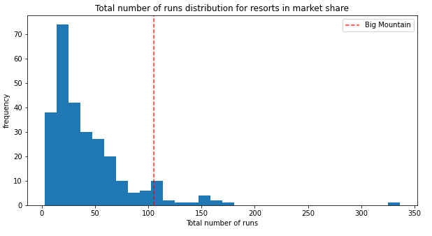
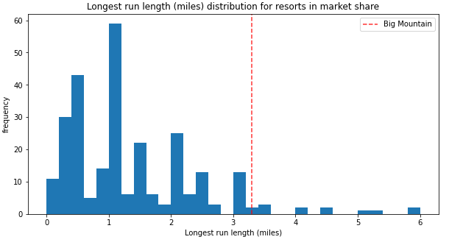
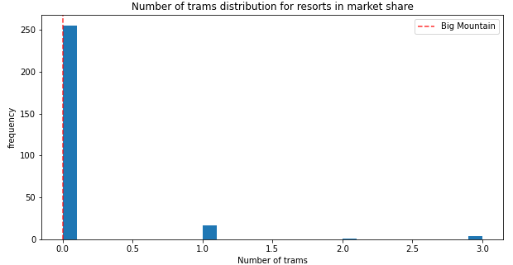
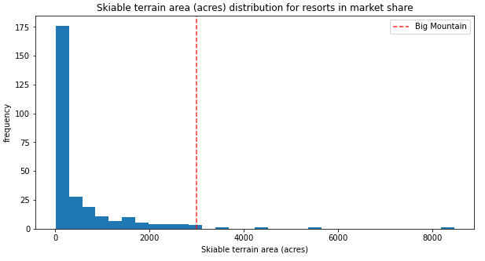
Modeling results and analysis (cont.)
B.M.S.R. is also displaying competitive numbers in having above average total number of runs (top left), longest run length (top right), skiable terrain (bottom right) and right around the median number of trams (bottom left).

Slide 7
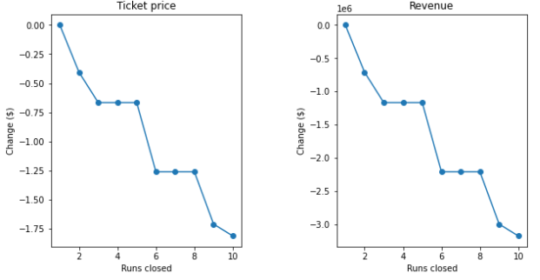
Modeling results and analysis (cont.)
Exploring scenarios to optimize B.M.S.R.
Option 1: Closing Trails and its effects on Revenue
Shown above (left) is how closing the 10 least used trails could change the price per ticket. The revenue projections are calculated based on an client provided expected number of 350,000 visitors in one season.
Other options results are explained in the summary results as a regression function made from existing data is used to explore options 2, 3 and 4.

Slide 8
Summary & Conclusion
Expected Ski Ticket Price: $95.87 Mean Absolute Error: +/- $10.39
TICKET PRICING ANALYSIS:
Graphs shown in the Modeling section shows B.M.S.R. to be competitive in 7 out of the 8 factors that dictate the price of a ski resort ticket. The 9 features were narrowed down from an original list of 14 features available. From mathematical models generated from the existing data on the 8 important factors, it was quantified that the expected price from being competitive in the features that B.M.S.R. is, it’s ticket price should be $95.87 (minimum, 85.48$, maximum of $106.26).
Option 1:
While exploring the revenue that would be lost from closing up to 10 of the least used runs, to make option 1 worthwhile, the money saved from reduction the maintenance cost would need to be factored to make an better business analysis.
Option 2:
These changes would signify a change of 1.99$ for the ticket price and could mount to a ~$3.5 Million increase in revenue.
Option 3:
These additional changes do not change the ticket price. The model generated shows that this option would not be better than option 2, and would be worse with the additional maintenance cost that would come with more acres of snow making.
Option 4:
The changes to the longest run and adding features that could make it more appealing do not show an increase ticket pricing based on the linear model developed.

